Slide 1
Database Appserv php&MySQL
劉秝瑋
2020/05/01

Slide 2
Outline
Appserv
PHP
MySQLi

Slide 3
APPserv
Appserv : Apache + PHP + MySQL
We can build the environment to learn PHP & MySQL.
Download: https://www.appserv.org/en/
Version : Appserv 9.3.0

Slide 4
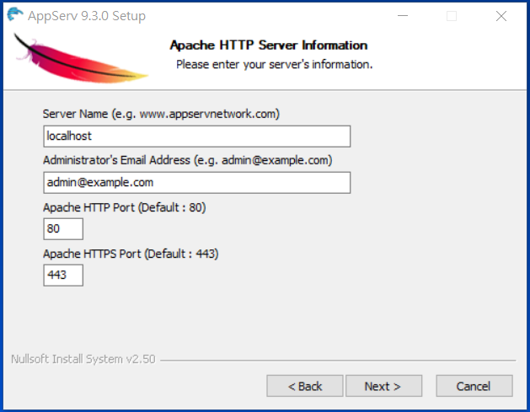
APPserv
Server Name

Slide 5
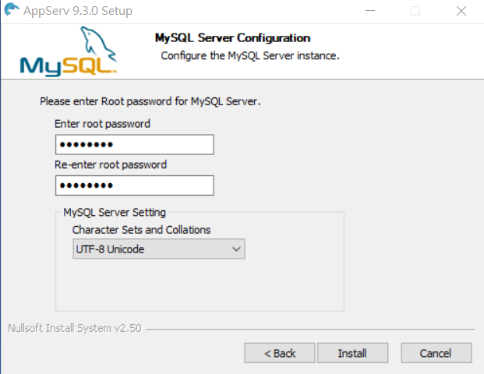
APPserv
password

Slide 6
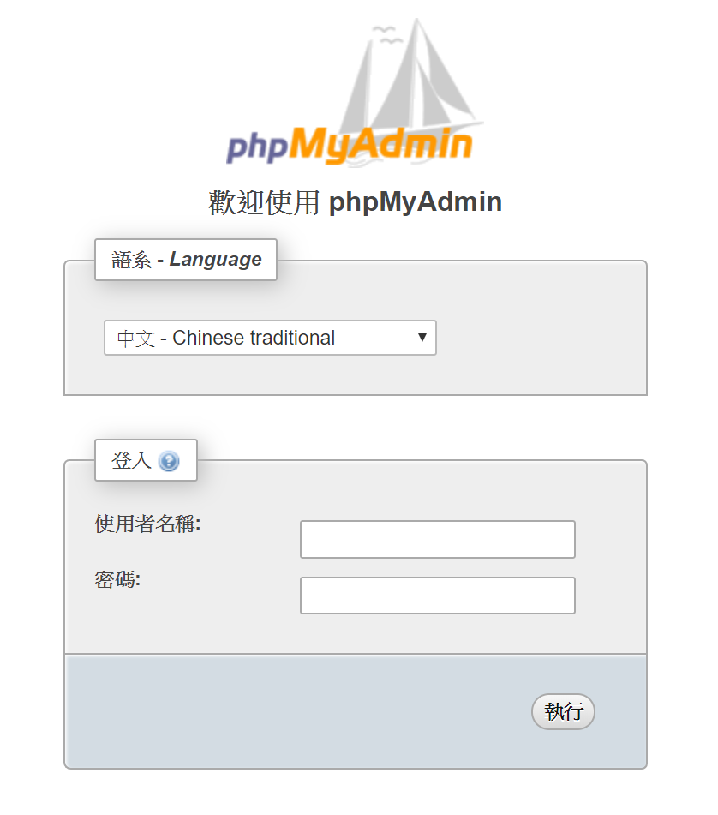
phpMyAdmin
Path: http://your_host/phpMyAdmin/
使用者名稱預設為: root
密碼為你下載時設定的 password
Notes:
也是 PHP 做出來的
是網頁介面，因此你在任何地方，只要能上網都能隨時管理你的 mySQL 資料庫

Slide 7
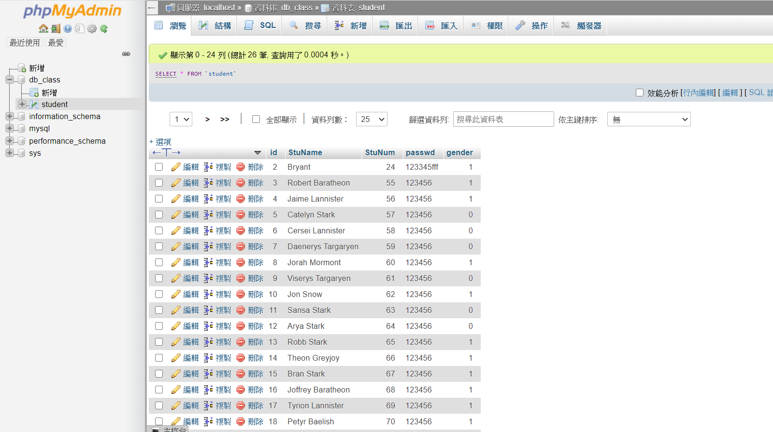
phpMyAdmin
Database
table
Data in table ‘student’
Notes:
phpMyAdmin:
是最被廣泛使用的 mySQL 管理介面
也是 PHP 做出來的
是網頁介面，因此你在任何地方，只要能上網都能隨時管理你的 mySQL 資料庫

Slide 8
HTML
<!DOCTYPE html>
<html>
<head>
<meta charset=utf-8">
<title>Page Title</title>
</head>
<body>
<h1>This is a Heading</h1>
<p>This is a paragraph.</p>
</body>
</html>

Slide 9
PHP
PHP is a server-side scripting language designed for web development.
PHP commands can be embedded into an HTML source document.
It’s Free!

Slide 10
PHP
<html>
<head>
<title>Hello World!</title>
</head>
<body>
<?php
echo "Hello! World!"; // It’s a comment.
?>
</body>
</html>

Slide 11
Variable & Type
Data Type
Boolean
Integer
Floating(double)
String
Array
Object
Resource
Null

Slide 12
Variable & Type(cont.)
Declare variable
$ + name , ex. $name = “Jon Snow”, $age = 23, …
$name = 'Arya Stark';
$class = 'database system';
$age = 18;
Declare Array
$msg [0] = "nice";
$msg = array("nice","to","meet","you");

Slide 13
Variable & Type(cont.)
Defines a constant
define("pi",3.14159);
echo constant("pi");
Notes:
恆常不變的值而稱作常數
常數在宣告之後，就無法再改變它的值

Slide 14
echo
The echo() function outputs one or more strings.
<?php
$name = 'Jon Snow';
echo 'Sum: ' . (1 + 2);
echo 'Hello ' . $name . '!';
?>
Notes:
逗號可以將字串變數和字串結合

Slide 15
Statement
If…else
While
Do…while
For
Foreach
Switch
Notes:
語法
除了常見的…. 還有 foreach

Slide 16
Statement(cont.)
Foreach
The foreach construct provides an easy way to iterate over arrays.
foreach ($listAll as $value ){
echo $value['id'].'<br>';
echo $value['data'].'<br>';
}

Slide 17
Function
<?php
function add($x,$y){
return $x + $y;
} $sum = add(3 + 7); // return is 10
?>

Slide 18
form
When the user fills out the form and clicks the submit button, the form data is sent for processing to a PHP file named "welcome.php". The form data is sent with the HTTP POST method.
Send.php
<form action="welcome.php" method="post">
Name: <input type="text" name="name"><br>
E-mail: <input type="text" name="email"><br>
<input type="submit">
</form>
welcome.php
Welcome <?php echo $_POST["name"]; ?><br>
Your email address is: <?php echo $_POST["email"]; ?>
Notes:
demo

Slide 19
HTTP method - Post & Get
GET
Identiﬁed by the Request-URI
The response to a GET request is cacheable
POST
Identiﬁed by the Request-URI in the Request-Line
The response to a Post request is not cache

Slide 20
MySQLi
PHP MySQLi = PHP MySQL Improved!
The MySQLi functions allows you to access MySQL database servers.

Slide 21
Connect Server
Send SQL Query
Process the Result
Release Connection
Notes:
與資料庫建立連線
送出 sql query
取得 result
釋放連線資源

Slide 22
Simple SQL query
Select:
SELECT * FROM SchoolGrade WHERE score = 100
Insert:
INSERT INTO Store_Information (store_name, Sales, Date) VALUES ('Los Angeles', 900, 'Jan-10-1999')
Delete:
DELETE FROM Store_Information WHERE store_name = "Los Angeles"
Update:
UPDATE Store_Information SET Sales = 500 WHERE store_name = "Los Angeles" AND Date = "Jan-08-1999"

Slide 23
Connect Server
$servername = "your_host";
$username = "your_user";
$password = "your_passwd";
$dbname = "your_dbname";
// Connecting to and selecting a MySQL database
$conn = new mysqli($servername, $username, $password, $dbname);
// Set up charset for Chinese language if (!$conn->set_charset("utf8")) {
echo "Error loading character set utf8: %s\n", $conn->error;
} else {
echo "Current character set: %s\n", $conn->character_set_name();
}
Notes:
new mysqli 物件 : 用以建立資料庫連線

Slide 24
Send SQL Query
mysqli_query(connection,sqlQuery)
e.g.
mysqli_query($conn , "SELECT StuName FROM Student");
Warning !!
You must be very careful when doing Update & Delete query.

Slide 25
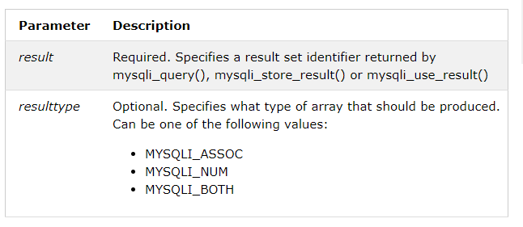
Process the Result
mysqli_fetch_array(result,resulttype)

Slide 26
Process the Result
mysqli_fetch_array(result,resulttype)
e.g.
while ( $row = mysqli_fetch_array ( $result, MYSQLI_NUM ) ) {
echo $row['0'].' '.$row['1'].' '.$row['2'].'<br>';
}
while($row = mysqli_fetch_array($result, MYSQLI_ASSOC)){
echo $row['id'].' '.$row['StuName'].' '.$row['StuNum'].'<br>';
}
Notes:
mysqli_fetch_array(result,resulttype)
將從資料庫取得的結果，依照選取的型態轉換成row

Slide 27
Release Connection
mysqli_close()
The mysqli_close() function closes a previously opened database connection.

Slide 28
Thanks for your attention.

